Slide 1


Customer Churn Prediction
By -
SHREENATH .S. GHATE
SHUBHAM KUMAR SINGH
PGP-DSBA (2022-23)
Under the Guidance of,
Mr. UDAY

Slide 2


INTRODUCTION
An E Commerce company provider is facing a lot of competition in the current market and it has become a challenge to retain the existing customers in the current situation. Hence, the company wants to develop a model through which they can do churn prediction of the accounts and provide segmented offers to the potential churners. In this company, account churn is a major thing because 1 account can have multiple customers hence by losing one account the company might be losing more than one customer.
We have been assigned to develop a churn prediction model for this company and provide business recommendations on the campaign. Our campaign suggestion should be unique and be very clear on the campaign offer because our recommendation will go through the revenue assurance team. If they find that we are giving a lot of free (or subsidized) stuff thereby making a loss to the company; they are not going to approve our recommendation.

Slide 3
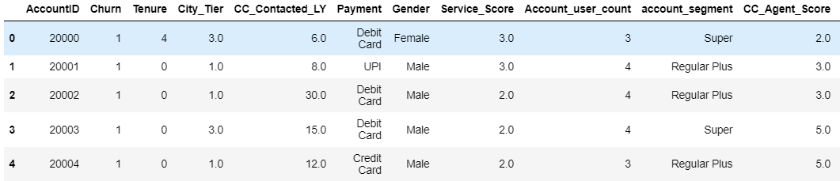

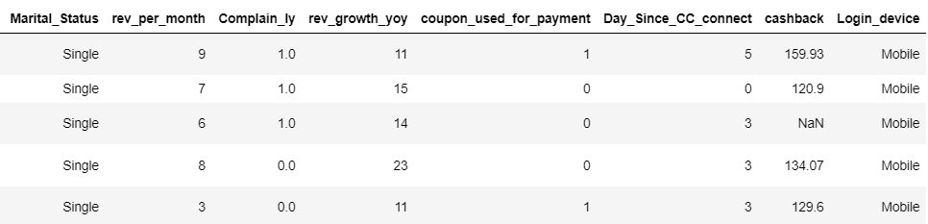
The dataset contains the following parameters (features):
Dataset

Slide 4
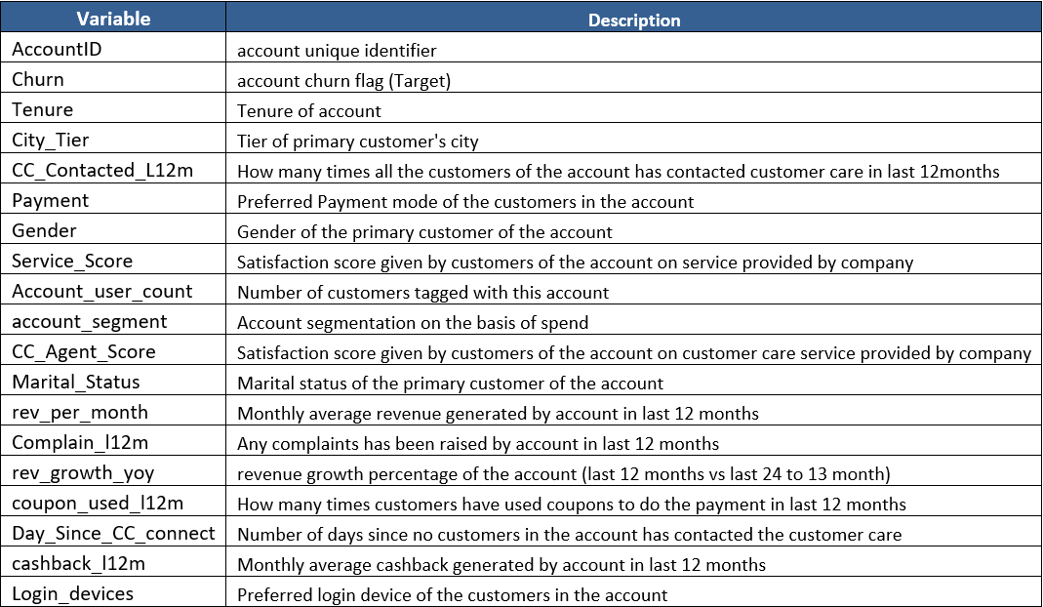
DATA DESCRIPTION

Slide 5
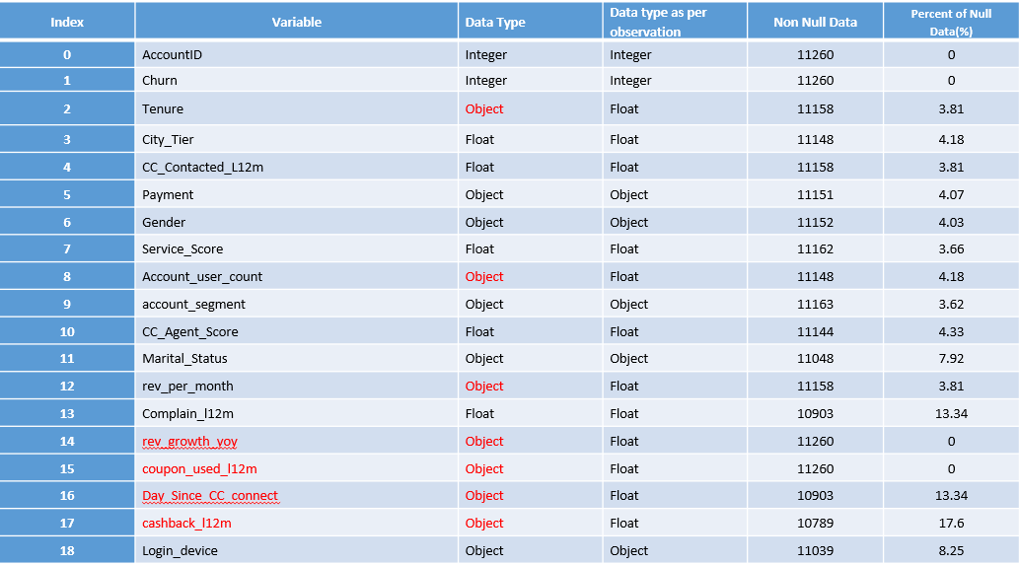
DATA PREPROCESSING
As we can observe from table there are 6 categorical columns which we have imputed with following mentods-
Payment- We have replace missing values with mode.
City Tier- We have replaced missing values with mode value.
Gender- We have replaced missing values with mode.
Marital_Status- We have replaced missing values with mode.
Cashback- We have replaced missing value with most accuring value which is 155.62.
Login_device- We have replaced missing values with mode.

Slide 6
FEATURE ENGINEERING
•Noise_index- We have created new column by deviding Tenure with CC_Contacted_LY.
•Benefit_recevby_customer- We have created new column by deviding Tenure with cashback.
As these two column will give us a idea which customers are those who contacted us most frequently and who are those customer who have received maximum benefit and their impact with other variables like account segment, cashback, revenue per month and churn.

Slide 7
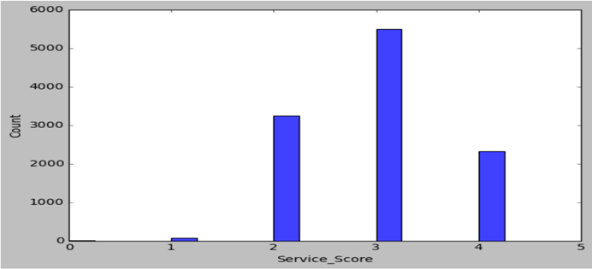
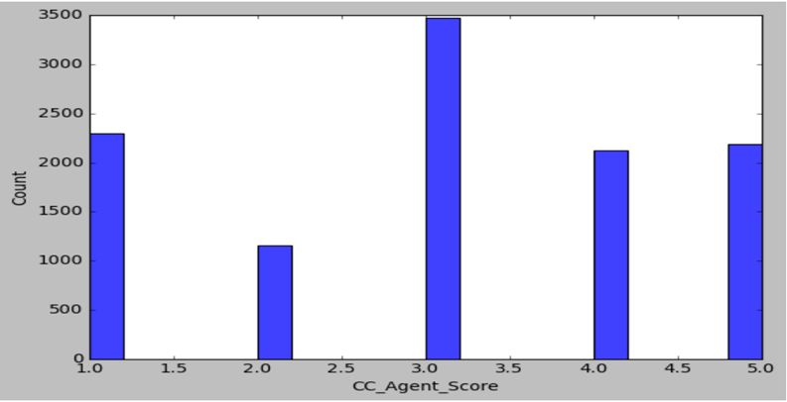
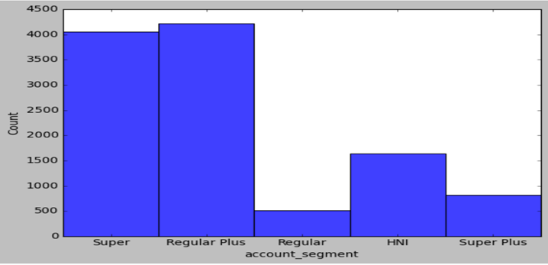
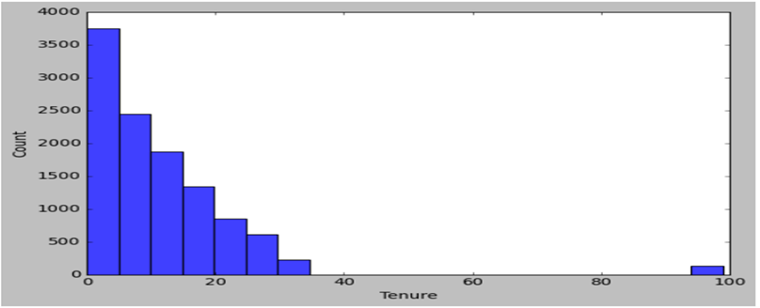
EDA - Univariate Analysis
1. Service_Score
3. CC_Agent_Score
Most of the customers have given a satisfaction score of 3 for the service provided followed by score of 2.
As most of the customers have given average service scores of 2 and 3, We can say that customers are not fully satisfied with the service provided.
Customers have given a score of 3 most of the time for the call center service provided.
All most equal no of customers have given high rating scores of 4 and 5 and a bad score of 1.
4. Account_Segment
2. Tenure
Segment Regular Plus has the maximum number of customers. Followed by the segment Super.
Regular segment has the least number of customers below 500.
Most of the customers have tenure of less than a month.

Slide 8
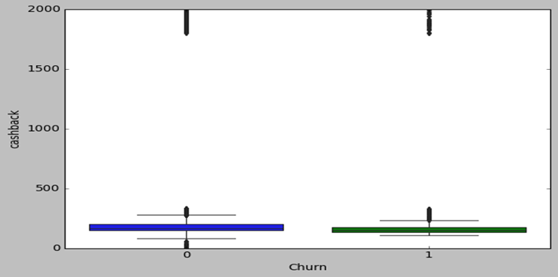
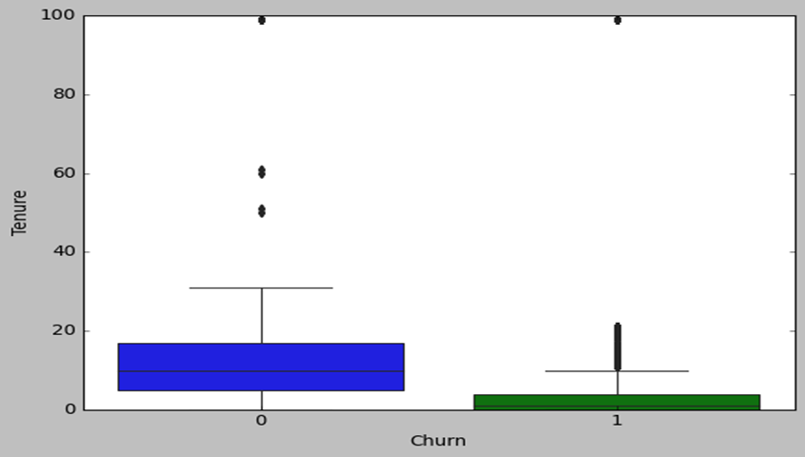
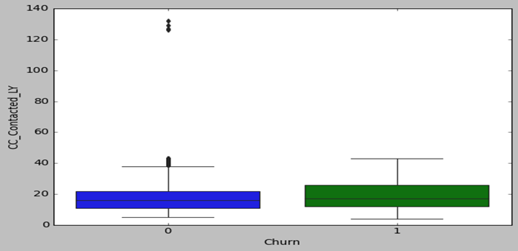
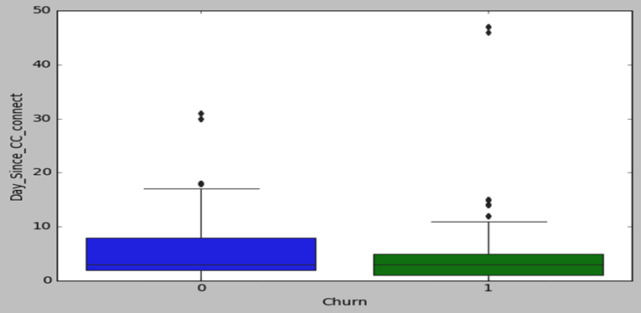
EDA - Bivariate Analysis
1. Churn Vs Cashback
3. Churn Vs Tenure
As we can observe from the above boxplot that cashback is not having any impact on customer churning. Both churned and not churned customer has taken average cashback of around 194 and 75% of total(both not churned & churned) customers has taken cashback of 198.
churned customer has low tenure than not churned customers the median is also very low. The overall mean is 10.98 and median is 9 and we can clearly see that for not curned customer median is close to 10 but churned customers close to 1. So higher the customer stays the lower is their chances to churn.
2. Churn Vs CC_Contacted
4. Churn Vs Account_Segment
The mean and median of CC_Contacted customers is quite similier which lies around 17.8(mean) and 16 although number of customers between 50-75% quartile of churned customers are slight more than not churned customers.
The mean and median for overall Day_since_cc_connect is 4.5(mean) and 3(median). The 3rd quartile(range between 50%-75%) for not churned customers are bit hight starting from 3 to 8 days.

Slide 9
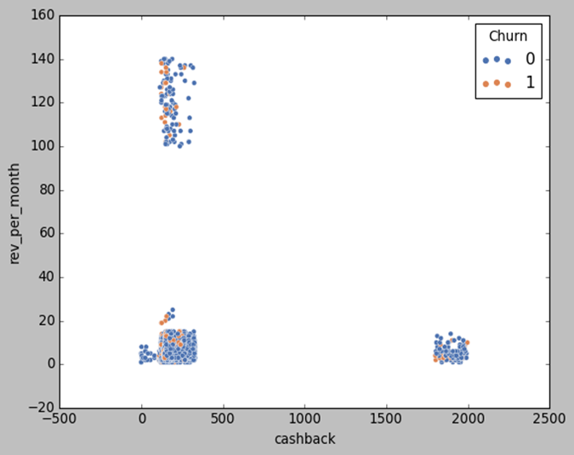
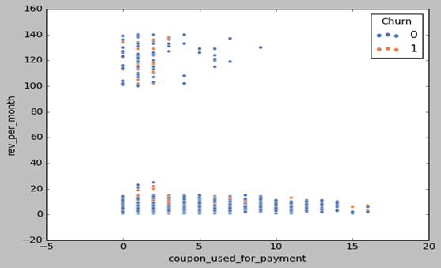
EDA - Multivariate Analysis
1. Cashback Vs Revenue per month Vs Churn
2. Coupon used for payment Vs Revenue per month Vs Churn
As we can observe from scatter plot and Table graph high account user count is not much impact on retaining the customers. Highest revenue generating accounts are those whose users per account are between 3 to 5 users per count.
As we can observe from scatter plot and Table graph there is no use of coupons on revenue per month and retaining the customers which means there is a scope to update coupon strategy.
As we can observe from scatter plot and Table graph that cashback utilized for not churned clients are slightly better than churned customers. Also we can observe from scatter plot that there is small cluster of higer revenue generating customer who are not able to utilize the higher cashbacks.

Slide 10
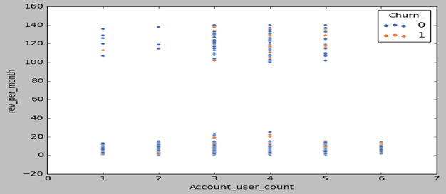
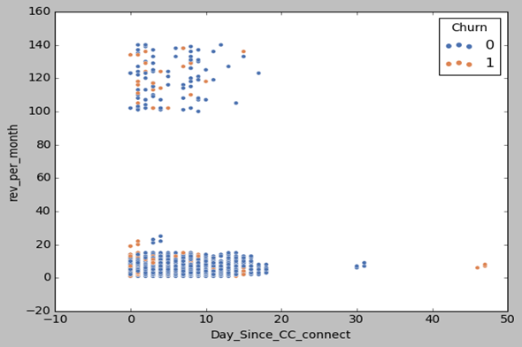
EDA - Multivariate Analysis
3. Account user count Vs Revenue per month Vs Churn
4. Day since CC connect Vs Revenue per month Vs Churn
As we can observe from scatter plot and Table graph high account user count is not much impact on retaining the customers. Highest revenue generating accounts are those whose users per account are between 3 to 5 users per count.
As we can observe from scatter plot and Table graph high account user count is not much impact on retaining the customers. Highest revenue generating accounts are those whose users per account are between 3 to 5 users per count.

Slide 11
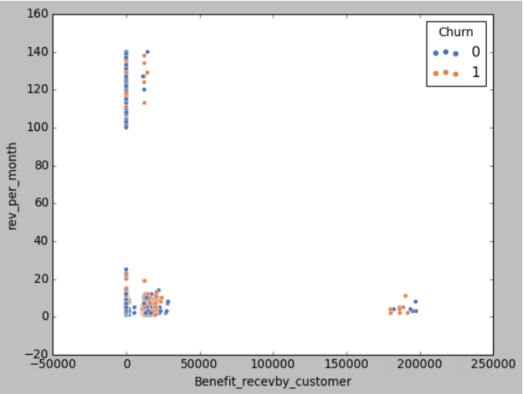
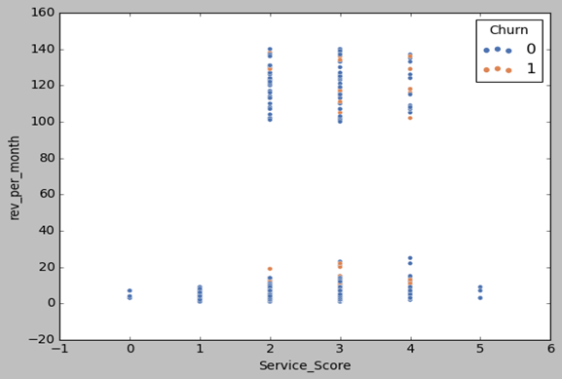
EDA - Multivariate Analysis
5. Benifit received by customer Vs Revenue per month Vs Churn
6. Service score Vs Revenue per month Vs Churn
From the scatter plot and cross tab analysis between benefit received by Customer and revenue per month we can see three clusters. Some of the customer fall in highest revenue bucket but the revenue per month is just between 0-20.
As we can observe from scatter plot and Table graph that our top three revenue generating customer in terms of their satisfaction score are service score 3 after that service score 2 then service score 4. We can say that we can work to provide better service to the customer segments who are giving us most of the revenue but their satisfaction is low.

Slide 12
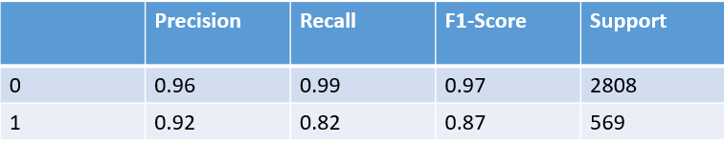
Final Model Interpretation
•Model Score - 0.95765472
Confusion Matrix
[[2770 38]
[ 105 464]]
•Classification Report

Slide 13
MODEL INTERPRETATION KEY POINTS
If the company is looking for a model, which can help them to target potential churning customers and thus helping them to reduce client acquisition cost than model with higher precision makes sense. As in this correctness of predicting churners is more important. Lower the percentage means that the company lost money on the respective lead.
If the company is looking to know high number of churners irrespective of cost of acquisition than recall makes more sense. Here they want to maximise prediction of employee opting for package.
We have chosed random Forest model for the following reason as it is less time consuming for implementation and any other model.
As we are working on E-commerce company data set we have to keep in mind for them precision and recall both the scores are important because for e commerce company prediction of those customers who are going to unsubscribe or churn the company is important for saving its budget on unproductive customers.
Also to know who are those customer which will not churn so that company can know they future sales pipeline and make its strategy accordingly.

Slide 14
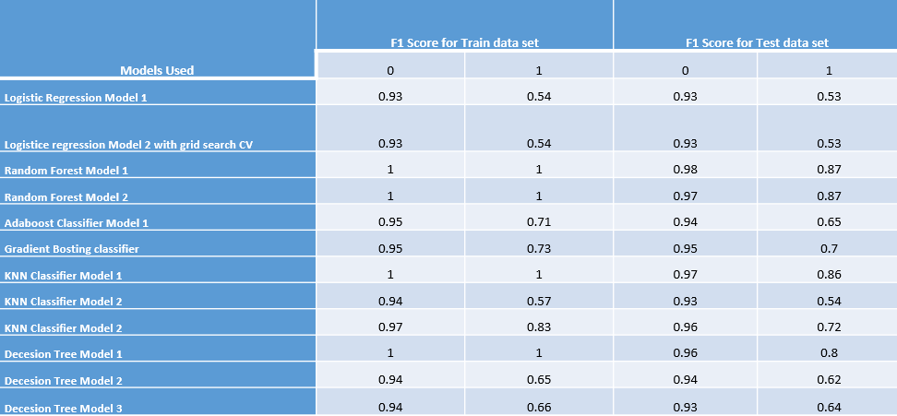
FINAL RECOMMENDATIONS
After summarizing all the model lets see the performance of various Models listed in tabular graph attached below

Slide 15
MAIN RESULT
Key area for improvement-
Segmentation Strategy
Cashback and Coupon strategy
Account User per count
Customer care Connect

Slide 16
MAIN RESULT
We can conclude that Logistic Regression and KNN Classifier is top 2 Models. Based on our F1 for Train & Test Data set we recommend the client Use Random Forest Model 2.
As our company is in E-commerce business so Customer Churning is very critical in terms of company’s revenue stream. From the complete analysis of the data and after applying various models we can come up with key recommendation-
1)- Company should re work on its segmentation strategy as customer segments is not showing any clear patterns as top 2 segments are not generating enough revenue.
2)- Company can work on those account where account user count is higher in numbers by providing them higher account upgrade offer as currently it has no positive effect on customer churning or company can sit with its marketing team for other strategies for these customers.
3)- For churned customers that have churned so based on our prediction company should make 2 strategies one for retaining churning customer by upgrading them to higher segments which will increase stickiness and providing cashbacks according to the revenue generated by the group historically.
4)- Based on the model prediction rather providing cashbacks to future churning customers company should focus to retain them by providing them some exclusive offers like account upgrade to premium segment which can reduce the company burden on cashbacks.
5)- For non-churning customer based on model prediction company can provide cashback offers based on revenue generated by that account.
6)- Regular Plus and Super is the category which contributes most number of customer but customer churn is also highest for these two categories company should start taking feedbacks and exit questionnaires from churning customers and exclusive segmented cashbacks and account upgrade programs company can run to retain them.

Slide 17
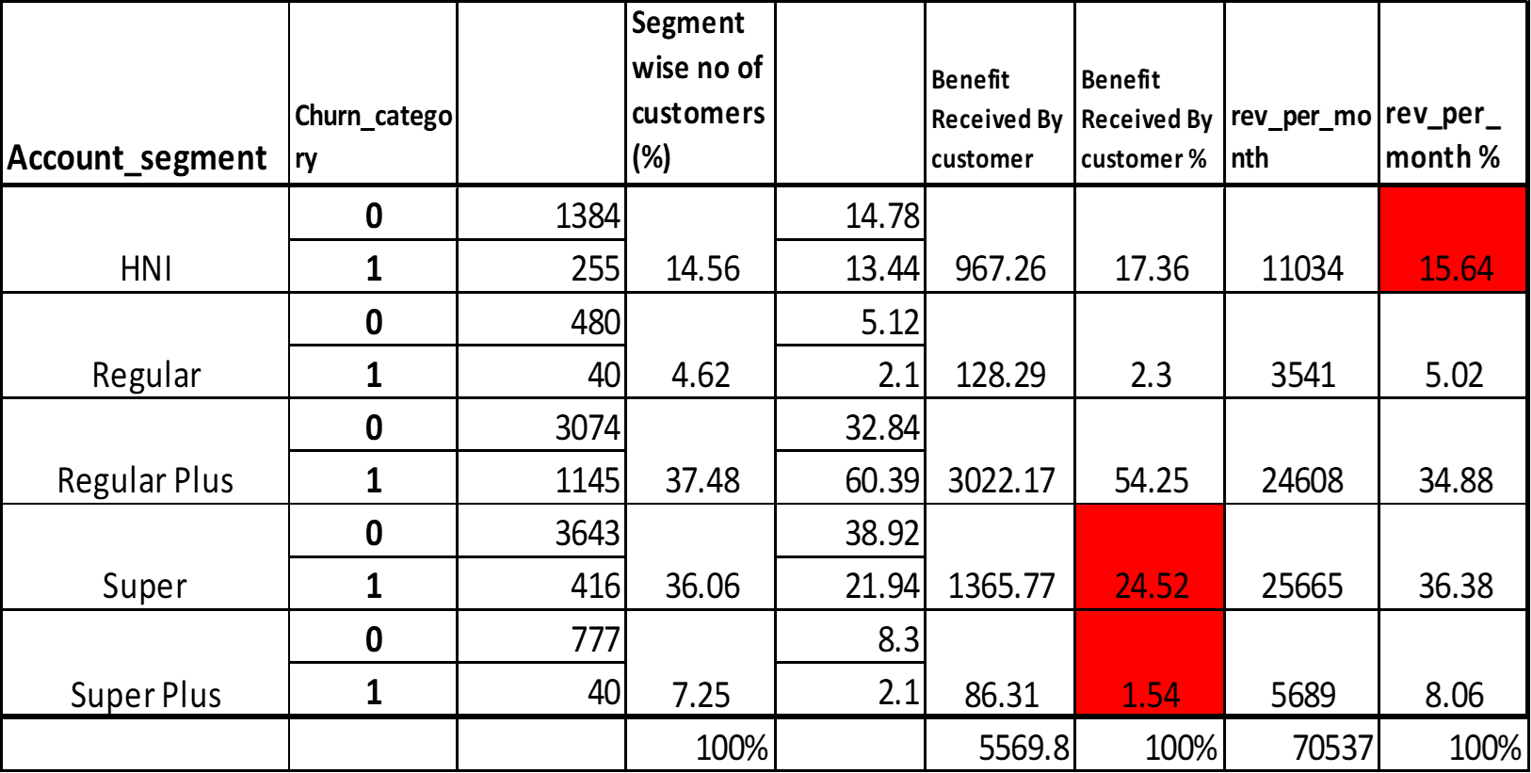

Slide 18
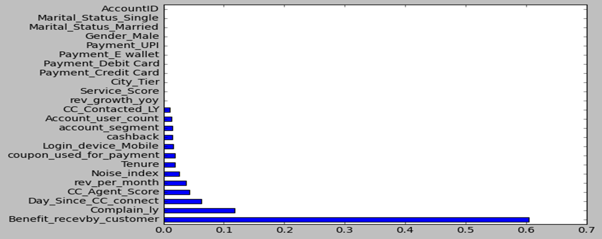
Implementation Posibilities
While adopting decision tree model we will get to know following are the important features which has their impact on model building.

Slide 19
While adopting some key recommendation company should focus on following points-
Regular Plus and Super are top two contributors in numbers but their revenue is not as per their percentage in contribution.
Most customer churned from Regular Plus category which is 60.39% out of total churned customer.
It is observed that company should make strategies to move its customer to higher segments, as most income generating category is regular plus and Super.
HNI & Super Plus segment should be focused more.
From all the EDA it is clearly known that even giving enough cashback to churned customers they have churned so based on our prediction company should make 2 strategies one for retaining churning customer by upgrading them to higher segments which will increase stickiness and providing cashbacks according to the revenue generated by the group historically.
Customer care team must make additional efforts to solve customer complaints at the earliest as majority of customers who raised a complaint in the past year has churned. Follow-up calls are recommended.

Slide 20
THANK YOU!

